Slide 1
Hotel Booking Data Analysis
Presented by: Ananya Verma
Date: 12-05-2026

Slide 2
Analysis Objectives
Analyze hotel booking trends and customer behavior
Study cancellations and booking performance
Identify profitability drivers
Understand seasonal booking patterns
Generate actionable business recommendations

Slide 3
Dataset Overview
Dataset Information
Total Records: 30,000
Total Columns: 25
Dataset Type: Hotel Booking Transactions
Important Columns
booking_channel
room_type
hotel_star_rating
city
booking_status
selling_price
cost_price
stay_duration
booking_date

Slide 4
Data Preparation
Calculated Columns: 1. Profit =Hotel_bookings_final[selling_price] -Hotel_bookings_final[costprice] 2.Stay_Duration=DATEDIFF(Hotel_bookings_final[check_in_date],Hotel_bookings_final[check_out_date], DAY)
3. Lead Time=DATEDIFF(check_in_date, booking_date) Measures
1.Booking Count=COUNTROWS(Hotel_bookings_final) 2. Cancellation_Rate =DIVIDE(CALCULATE(COUNTROWS(Hotel_bookings_final), Hotel_bookings_final[booking_status] = "Cancelled"),COUNTROWS(Hotel_bookings_final))
3. Revenue=SUM(Hotel_bookings_final[booking_value])
4. Total_Profit =SUMX(Hotel_bookings_final,Hotel_bookings_final[selling_price] -
Hotel_bookings_final[costprice])
5. Cancellation Count=CALCULATE( COUNTROWS(Hotel_bookings_final),Hotel_bookings_final[booking_status] = "Cancelled")

Slide 5
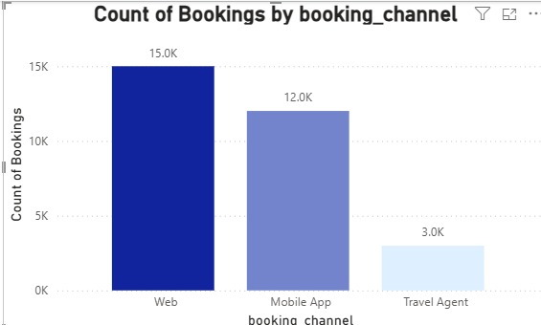
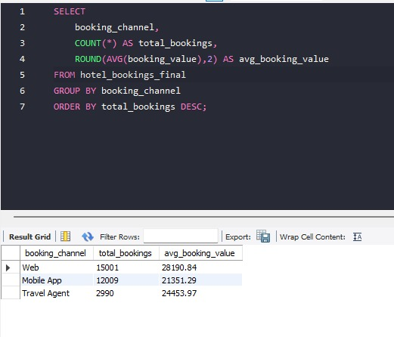
Booking Trends Across Channels
Observed patterns and trends
Average Booking Value Analysis
Web bookings showed the highest average booking value (~28,191).
Travel Agent bookings generated moderate average booking value (~24,454).
Mobile App bookings recorded the lowest average booking value (~21,351).
Pattern Identified
Customers strongly prefer digital self-booking platforms over offline booking methods.
Web platform dominates overall booking acquisition.
Mobile application also plays a significant role in customer bookings.

Slide 6
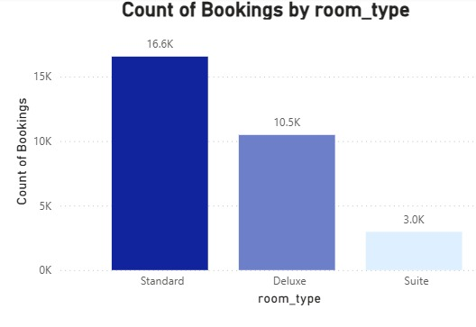
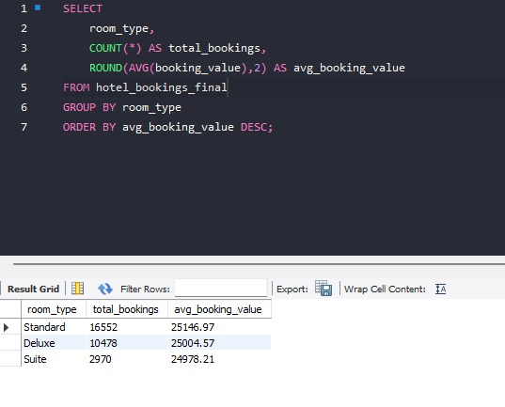
Booking Patterns by Room Type

Slide 7
Key Observations
Standard rooms recorded the highest booking volume with approximately 16,552 bookings.
Deluxe rooms contributed around 10,478 bookings, indicating moderate customer demand.
Suite rooms had the lowest booking volume with approximately 2,970 bookings.
Average Booking Value Analysis
Standard rooms generated the highest average booking value (~25,147).
Deluxe rooms showed slightly lower average booking value (~25,005).
Suite rooms recorded the lowest average booking value (~24,978).
Pattern Identified
Customers prefer affordable and mid-range accommodation options over premium room categories.
Booking demand is concentrated heavily in Standard room segments.
Premium room categories attract comparatively smaller customer segments.
Business Interpretation
Standard rooms are the primary demand driver and contribute significantly to total booking volume.
Lower Suite bookings may indicate price sensitivity among travelers.
Mid-range room categories appear to balance both affordability and customer demand effectively.
Recommendations
Focus promotions and pricing optimization on Standard and Deluxe room categories.
Introduce bundled offers or premium experience upgrades to improve Suite bookings.
Use upselling strategies to move customers from Standard to Deluxe categories.

Slide 8
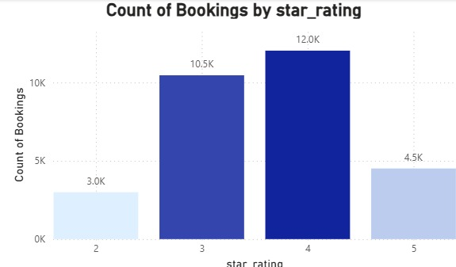
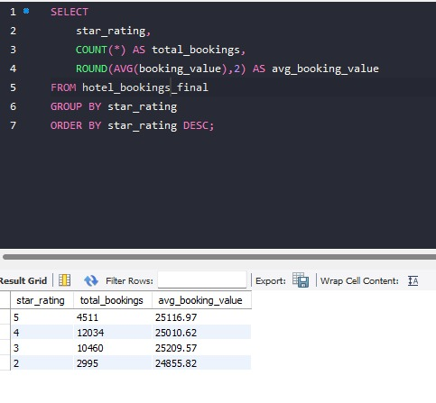
Booking Patterns by Star Rating

Slide 9
Key Observations
4-star hotels recorded the highest booking volume with approximately 12,034 bookings.
3-star hotels contributed around 10,460 bookings, showing strong mid-range customer demand.
5-star hotels generated moderate booking volume with approximately 4,511 bookings.
2-star hotels recorded the lowest booking count with approximately 2,995 bookings.
Average Booking Value Analysis
5-star hotels achieved the highest average booking value (~25,117).
4-star hotels generated strong average booking value (~25,011).
3-star and 2-star hotels showed comparatively lower booking values.
Pattern Identified
Customers primarily prefer mid-range hotel categories such as 3-star and 4-star properties.
Premium luxury hotels attract fewer but higher-value bookings.
Budget hotel categories contribute relatively lower booking demand.
Business Interpretation
Mid-range hotels represent the strongest market segment in terms of customer demand.
4-star hotels balance affordability and premium experience effectively.
5-star hotels contribute higher revenue per booking despite lower booking volume.
Recommendations
Focus promotions and inventory optimization on 3-star and 4-star hotels.
Use premium upselling strategies for luxury hotel categories.
Create targeted offers for budget travelers to improve low-star hotel occupancy.
Strengthen pricing optimization for high-demand mid-range hotel segments.

Slide 10
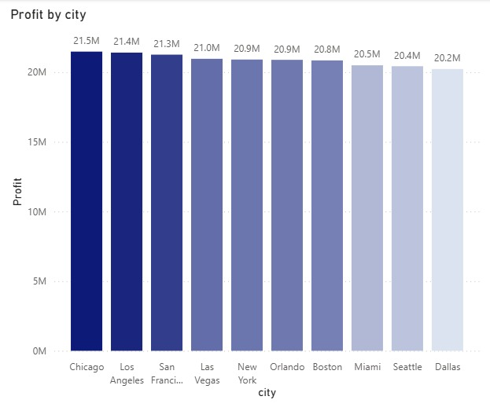
Profitability by City

Slide 11
Key Observations
Chicago generated the highest profitability with approximately 21.5M profit.
Los Angeles and San Francisco also contributed strong profitability exceeding 21M.
Dallas recorded the lowest profitability among the displayed cities with approximately 20.2M profit.
Profit distribution across major cities remains relatively stable with only moderate variation.
Pattern Identified
Large metropolitan cities consistently contribute higher profitability.
High-demand urban destinations appear to drive stronger hotel revenue performance.
Profitability differences between cities are comparatively narrow, indicating balanced market performance.
Business Interpretation
Major business and tourism hubs contribute significantly to overall platform profitability.
Cities with strong travel demand likely benefit from higher booking volume and premium hotel pricing.
Stable profitability across cities suggests diversified revenue generation rather than overdependence on a single market.
Root Cause Analysis
Higher tourism and business travel activity in metropolitan cities
Better hotel inventory availability
Higher average booking values in premium urban markets
Stronger occupancy rates throughout the year

Slide 12
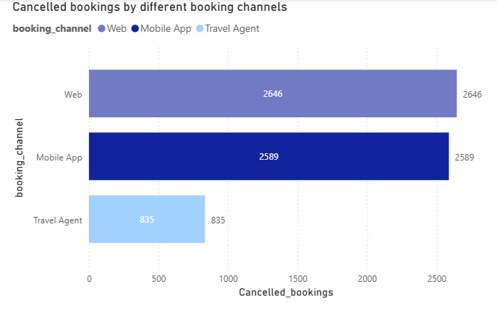
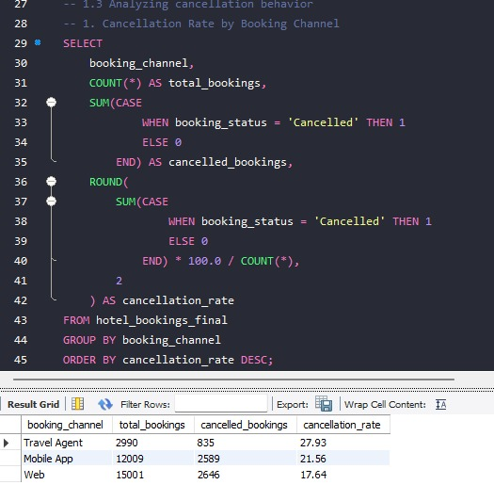
Cancellation Analysis

Slide 13
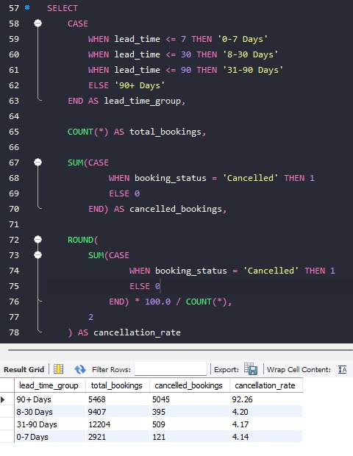
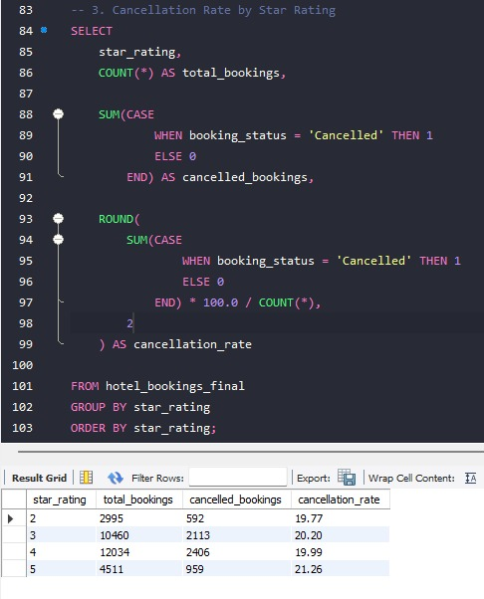
Cancellation Rate Based on Lead Rime and Star Rating

Slide 14
Key Observations:
Booking Channel Cancellation Trends
Web channel recorded the highest number of cancelled bookings with approximately 2,646 cancellations.
Mobile App channel showed nearly similar cancellation volume with around 2,589 cancellations.
Travel Agent channel generated the lowest cancellation count with approximately 835 cancellations.
Cancellation Rate Analysis by Channel
Booking Channel | Cancellation Rate
Travel Agent | 27.93%
Mobile App | 21.56%
Web | 17.64%
Insights
Travel Agent bookings had the highest cancellation rate despite lower booking volume.
Web bookings demonstrated comparatively stronger booking stability.
Mobile App users showed moderate cancellation behavior.

Slide 15
Cancellation Trends by Lead Time
Lead Time Group | Cancellation Rate
90+ Days | 92.26%
8–30 Days | 4.20%
31–90 Days | 4.17%
0–7 Days | 4.14%
Key Findings
Long lead-time bookings (90+ days) showed extremely high cancellation probability.
Short and medium lead-time bookings remained comparatively stable.
Cancellation risk increases significantly as booking lead time increases.
Cancellation Trends by Star Rating
Star Rating | Cancellation Rate
5-Star | 21.26%
3-Star | 20.20%
4-Star | 19.99%
2-Star | 19.77%

Slide 16
Insights
5-star hotels experienced the highest cancellation rate.
Premium hotel bookings appear more volatile than budget and mid-range segments.
Luxury travelers may demonstrate more flexible or uncertain travel intent.
Pattern Identified
High-value and long-term bookings are more likely to be cancelled.
Direct Web bookings show relatively better customer commitment.
Travel Agent bookings appear less stable despite lower overall volume.
Premium hotel categories experience comparatively higher cancellation risk.

Slide 17
Cancellation Root Cause Analysis
1. Reasons for Observed Cancellation Patterns
Observation 1 : Travel Agent bookings have the highest cancellation rate
From SQL analysis:
Travel Agent cancellation rate = 27.93%
Mobile App = 21.56%
Web = 17.64%
Root Cause
Travel-agent bookings are more cancellation-prone because:
customers compare multiple hotel options before finalizing
third-party bookings involve lower direct customer commitment
cancellation and refund processes are easier through intermediaries
Direct web bookings showed stronger booking intent and customer reliability.

Slide 18
Observation 2: Long lead-time bookings show extremely high cancellations
Lead-time analysis revealed:
bookings with 90+ days lead time had cancellation rate above 90%
shorter lead-time bookings remained near 4%
Root Cause
Customers booking far in advance are more likely to:
change travel plans
postpone trips
shift to better offers later
This indicates uncertainty increases significantly with larger booking windows.
Observation 3 : Premium hotels show slightly higher cancellation rates
5-star hotels had the highest cancellation rate among star categories.
Root Cause
Premium customers generally:
book earlier
maintain flexible travel schedules
frequently compare luxury alternatives
Luxury travel demand is more dynamic than budget travel demand.

Slide 19
2. Why Some Booking Channels or Property Types Perform Better
Observation 1 :Web channel dominates both bookings and revenue
From Power BI:
Web generated highest booking count (15K)
Web also generated highest revenue (0.42bn)
Web contributed highest profitability across both business and leisure stays
Root Cause
Web channel performed best because:
direct customer access
lower intermediary commission costs
better digital convenience
stronger online customer adoption
It also maintained the lowest cancellation rate among all channels.
Observation 2 : 4-star hotels receive maximum bookings
From star-rating analysis:
4-star hotels recorded highest bookings (12K)
followed by 3-star hotels (10.5K)
Root Cause
4-star hotels likely offer:
optimal balance between luxury and affordability
broader appeal to both business and leisure travelers
better amenities at moderate pricing
This segment captures the largest market demand.

Slide 20
Observation 3 : Leisure stays generate higher profitability
From booking-channel performance chart:
Leisure bookings consistently produced higher profit than business bookings across all channels
Examples:
Web Leisure Profit = 63M
Web Business Profit = 41M
Root Cause
Leisure travelers likely:
stay longer
spend more on premium services
book family/group accommodations
This increases overall booking value and profitability.
Observation 4 : Standard rooms generate maximum revenue
From room-type revenue chart:
Standard rooms contributed 0.42bn
Deluxe = 0.26bn
Suite = 0.07bn
Root Cause
Standard rooms dominate because:
affordable pricing attracts larger customer segments
higher occupancy rates
balanced price-to-value perception
Premium suites generate higher value per booking but significantly lower demand volume.

Slide 21
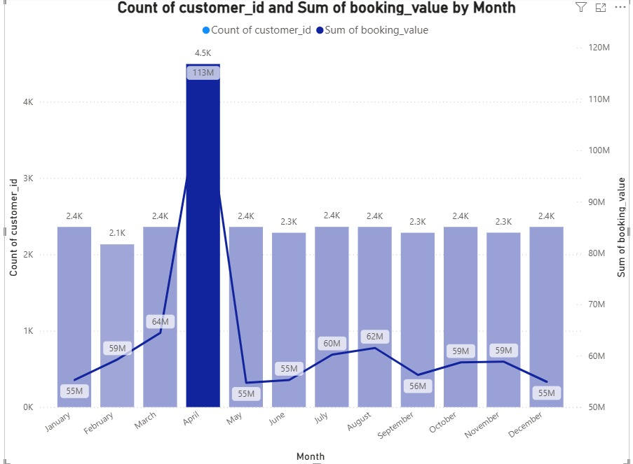
3.Seasonal and Temporal Trends Influencing Booking Values

Slide 22
Observation : April recorded unusually high revenue and bookings
Monthly trend analysis showed:
April revenue peaked at 113M
booking count also reached maximum (4.5K)
Stable Booking Activity Across Remaining Months
Most months maintained booking counts between 2.3K – 2.4K.
Revenue across non-peak months remained relatively stable between 55M – 62M.
Seasonal fluctuations were concentrated primarily around peak periods.
Mid-Year Revenue Recovery Trend
Revenue showed moderate recovery during July and August.
August recorded approximately 62M booking value after earlier decline post-April peak.
Indicates secondary seasonal demand periods during mid-year travel months.
Root Cause
This indicates:
seasonal travel demand surge
holiday/vacation travel peaks
higher occupancy and room pricing during peak periods

Slide 23
Business Recommendations
1. Strategies to Reduce Cancellations
A. Introduce Tiered Cancellation Policies
Since long lead-time bookings showed extremely high cancellation rates:
apply stricter cancellation rules for bookings made far in advance
introduce partial refund policies instead of full refunds
encourage prepaid bookings with discounts
B. Strengthen Direct Web Bookings
Web bookings had the lowest cancellation rate.
Recommended actions:
promote direct booking discounts
provide loyalty benefits for website/app bookings
reduce dependency on travel-agent channels
This improves booking reliability and reduces intermediary losses
C. Use Predictive Cancellation Monitoring
Use lead time, booking channel, and star rating to identify high-risk bookings.
High-risk customers can receive:
reminder emails
reconfirmation requests
targeted offers before cancellation occurs
This can reduce preventable cancellations.

Slide 24
2. Recommendations to Improve Profitability and Increase Repeat Bookings
A. Focus on High-Performing Segments
Analysis showed strongest profitability from:
Web channel
Leisure stays
4-star hotels
Business should:
allocate higher marketing budget toward these segments
prioritize premium mid-range hotel offerings
improve digital customer acquisition
B. Launch Customer Loyalty Programs
Repeat bookings can increase through:
reward points
member-exclusive pricing
cashback and upgrade offers
personalized discounts for repeat customers
This improves customer retention and lifetime value.
C. Increase Revenue per Customer
Leisure travelers generated higher profits.
Opportunities:
bundle packages
premium room upgrades
extended-stay discounts
add-on services (transport, dining, experiences)
This increases average booking value.

Slide 25
3. Opportunities to Optimize Pricing, Promotions, and Channel Strategy
A. Dynamic Seasonal Pricing
April showed exceptionally high demand and revenue.
Recommended strategy:
increase prices during peak demand months
optimize occupancy-based pricing
apply surge pricing during holidays and travel seasons
This maximizes revenue during high-demand periods.
B. Optimize Channel Investment
Performance analysis showed:
Web channel generated highest revenue and lowest cancellations
Travel-agent channel performed weakest
Recommended actions:
prioritize digital marketing for direct channels
reduce excessive commission-based dependency
improve mobile/web booking experience
C. Segment-Based Promotions
Different customer segments should receive targeted offers.
Examples:
early-bird offers for leisure travelers
weekday promotions for business travelers
personalized discounts based on booking history
This improves conversion rates and occupancy consistency.

Slide 26
Final Business Summary
Key Findings
Web channel generated the highest booking volume, revenue, and profitability while also maintaining the lowest cancellation rate.
Travel Agent bookings showed the highest cancellation rate despite lower booking contribution.
Standard rooms and 4-star hotels dominated customer demand and overall revenue generation.
Leisure travelers contributed significantly higher profitability compared to business travelers.
Long lead-time bookings (90+ days) had extremely high cancellation probability.
Metropolitan cities such as Chicago, Los Angeles, and San Francisco delivered the strongest profitability.
April emerged as the peak revenue and booking month, indicating strong seasonal demand patterns.
Major Business Opportunities
Strengthen direct booking channels to improve profitability and reduce dependency on intermediaries.
Optimize pricing during high-demand seasonal periods using dynamic pricing models.
Increase customer retention through loyalty programs and personalized offers.
Improve premium room and luxury hotel occupancy using targeted upselling and bundled experiences.
Use predictive cancellation monitoring to reduce revenue leakage from high-risk bookings.
Strategic Recommendations
Prioritize marketing investment toward Web and Mobile App channels.
Implement stricter cancellation policies for long lead-time bookings.
Focus inventory and promotional efforts on high-performing 4-star and Standard room segments.
Introduce customer segmentation strategies for leisure, premium, and repeat travelers.
Expand ancillary revenue opportunities through upgrades, bundled packages, and add-on services.
Expected Business Impact
Reduced cancellation losses
Higher repeat booking rates
Improved occupancy consistency
Increased average booking value
Better profitability across key customer segments and cities

